Slide 1
Polar or Non Polar?
Some steps to help you figure it out

Slide 2
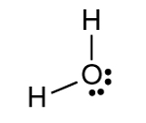
1. Determine the Lewis Structure of the molecule
Ex. H₂O vs. CO₂

Slide 3
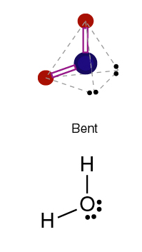
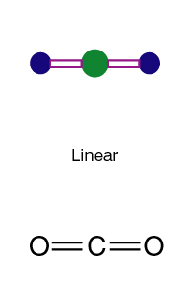
2. Determine the shape

Slide 4
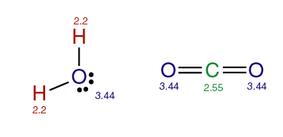
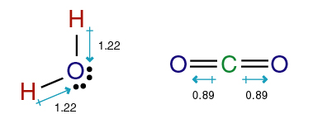
3. Determine the molecular polarity

Slide 5
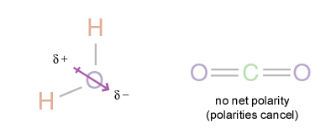
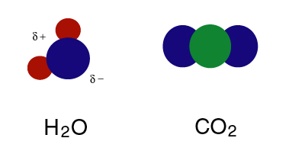
4. Do the bond polarities cancel each other out, or is there a net polarity?

