Slide 1
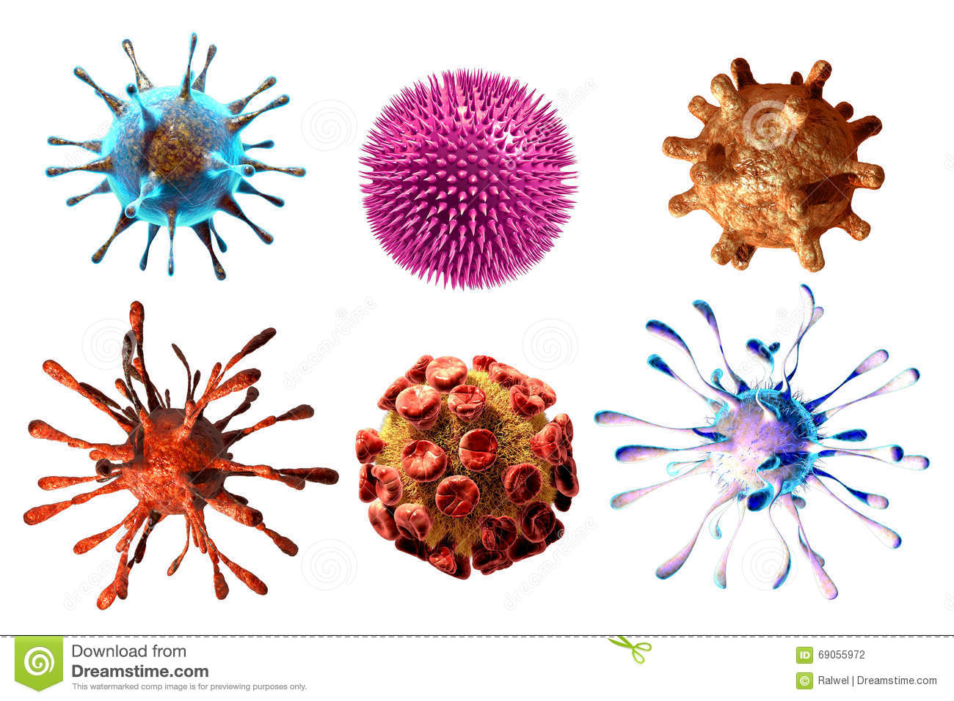
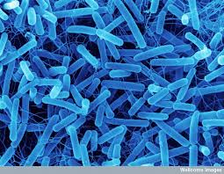
Topic 1.4: What interactions occur between humans and non - living organisms

Slide 2
ALL microbes are BAD.

Slide 3
Step 1:
write down questions you have after reading the prompt
Write down as many questions as you can
Do not stop to judge, discuss, edit or answer any question

Slide 4
Step 2:
Classify your question as open ended or close ended
Closed ended: Questions that can be answered with a yes or no answer
Open ended: Questions that require more thought or more than just a one word answer

Slide 5
Step 3:
Re-write your closed ended questions to make then into open ended questions

Slide 6
Step 4:
Select the 3 most interesting questions from your group

Slide 7
What are some positive and negative ways that we interact with microbes?

Slide 8
What are micro-organisms?
A micro-organism, or microbe for short, is simply an organism that is realy small.
Two examples are bacteria and plankton

Slide 9
How are they our friends?

Slide 10
Phytoplankton and algae are responsible for creating majority of our oxygen supply

Slide 11
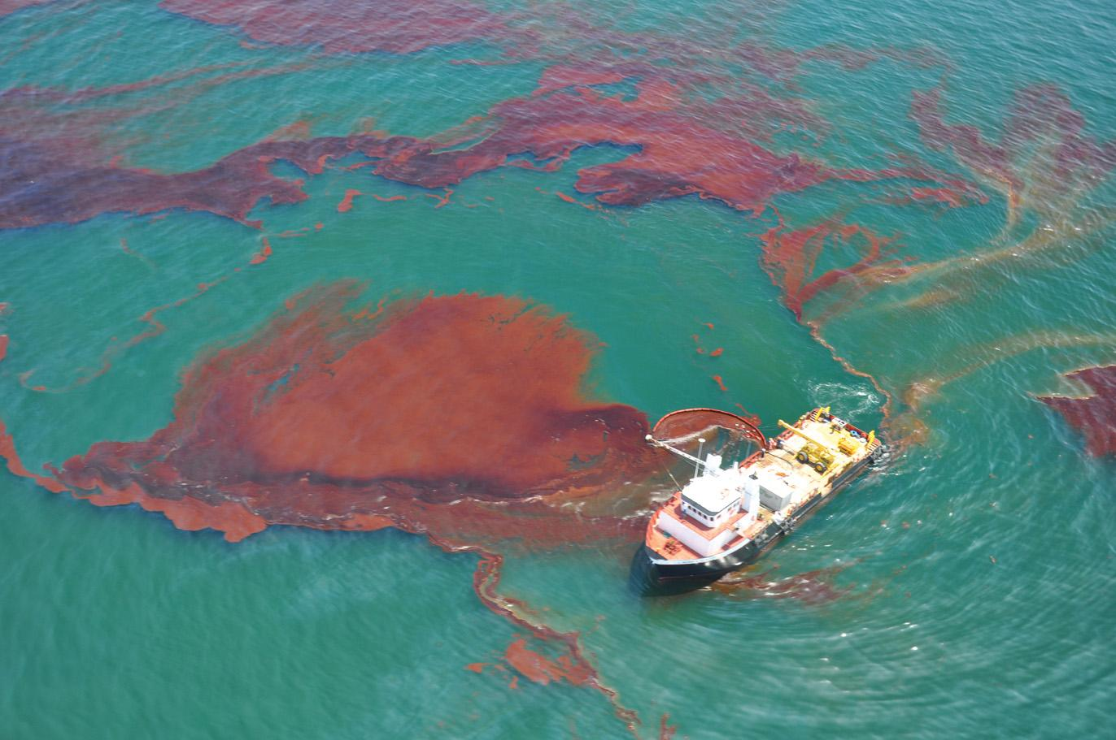
Some bacteria are used to clean oil spills

Slide 12
Bacteria decompose dead things (as waste) to recycle nutrients

Slide 13
Bacteria create drugs like penicillin and insulin

Slide 14
Lactobacteria create cheese, yogurt (others ferment ie. pickles, soy sauce)

Slide 15
Bacteria in our intestines digest our food, create vitamins for us

Slide 16
How are they NOT our friends?

Slide 17
Bacteria contaminate food and create toxins ie. food poisioning

Slide 18
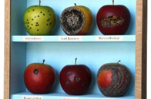
Bacteria will spoil food and decrease shelf life

Slide 19
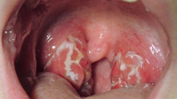
Pathogens are bacteria that harm us, like stretococcus bacteria

Slide 20
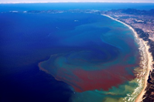
When phytoplankton grow out of control it create red tide (causes toxins in shellfish, makes us sick)

Slide 21
Meet your microbes!
https://www.ted.com/talks/jonathan_eisen_meet_your_microbes
Notes:
If you have time to kill

Slide 22
Activity
1) Go to the following website: https://goo.gl/4fBDQ2
2) Scroll down and click “start exploring”
3) Explore the microbes under the microscope and pick one that interests you. Complete the table below.
4) Share with another person in the class

